Slide 1
Logic in AI
Contd. Agenda:DPLL Algo, FIRST ORDER LOGIC
Session 12

Slide 2
SAT: Model Finding
Find assignments to variables that makes a formula true
39

Slide 3
Why study Satisfiability?
Canonical NP complete problem.
– several hard problems modeled as SAT
Tonne of applications
State-of-the-art solvers superfast

Slide 4
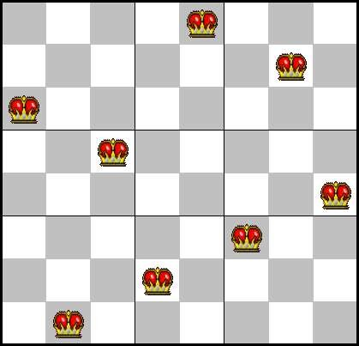
SAT Translation of N-Queens
At least one queen each column:
(Q11 v Q12 v Q13 v ... v Q18) (Q21 v Q22 v Q23 v ... v Q28)
…
No attacks: (~Q11 v ~Q12) (~Q11 v ~Q22) (~Q11 v ~Q21)
...

Slide 5
Inference 3: Model Enumeration
for (m in truth assignments){ if (m makes Φ true)
then return “Sat!”
}
return “Unsat!”

Slide 6
Inference 4: DPLL (Enumeration of Partial Models)
[Davis, Putnam, Loveland & Logemann 1962]
Version 1
dpll_1(pa){
if (pa makes F false) return false; if (pa makes F true) return true; choose P in F;
if (dpll_1(pa ∪ {P=0})) return true; return dpll_1(pa ∪ {P=1});
}
Returns true if F is satisfiable, false otherwise

Slide 7
DPLL Version 1
(a ∨ b ∨ c) (a ∨ ¬b)
(a ∨ ¬c)
(¬a ∨ c)

Slide 8
DPLL Version 1
a
(a ∨ b ∨ c) (a ∨ ¬b)
(a ∨ ¬c)
(¬a ∨ c)
F

Slide 9
DPLL Version 1
a
(F ∨ b ∨ c) (F ∨ ¬b)
(F ∨ ¬c)
(T ∨ c)
F

Slide 10
DPLL Version 1
a
(F ∨ F ∨ c) (F ∨ T)
(F ∨ ¬c)
(T ∨ c)
F
b

Slide 11
DPLL Version 1
a
(F ∨ F ∨ F) (F ∨ T)
(F ∨ T)
(T ∨ F)
F
b
c

Slide 12
DPLL Version 1
a
F T T T
F
b
c

Slide 13
DPLL Version 1
a
(a ∨ b ∨ c) (a ∨ ¬b)
(a ∨ ¬c)
(¬a ∨ c)
b
c

Slide 14
DPLL Version 1
a
(a ∨ b ∨ c) (a ∨ ¬b)
(a ∨ ¬c)
(¬a ∨ c)
b
b
c
c

Slide 15
DPLL as Search
Search Space?
Algorithm?

Slide 16


Improving DPLL
If literal L₁ is true, then clause (L₁ ∨ L₂ ∨ ...) is true
If clause C₁ is true, then C₁ ∧ C₂ ∧ C₃ ∧ ... has the same value as C₂ ∧ C₃ ∧ ...
Therefore: Okay to delete clauses containing true literals!
If literal L₁ is false, then clause (L₁ ∨ L₂ ∨ L₃ ∨ ...) has the same value as (L₂ ∨ L₃ ∨ ...)
Therefore: Okay to delete shorten containing false literals! If literal L₁ is false, then clause (L₁ ) is false
Therefore: the empty clause means false!

Slide 17
DPLL version 2
dpll_2(F, literal){
remove clauses containing literal
if (F contains no clauses)return true; shorten clauses containing ¬literal if (F contains empty clause)
return false;
choose V in F;
if (dpll_2(F, ¬V))return true; return dpll_2(F, V);
}

Slide 18
DPLL Version 2
a
(F ∨ b ∨ c) (F ∨ ¬b)
(F ∨ ¬c)
(T ∨ c)
F

Slide 19
DPLL Version 2
a
(b ∨ c)
(¬b)
(¬c)

Slide 20
DPLL Version 2
a
(F ∨ c)
(T)
(¬c)
b

Slide 21
DPLL Version 2
a
(c)
b
(¬c)

Slide 22
DPLL Version 2
a
(F)
b
(T)
c

Slide 23

DPLL Version 2
a
()
b
c

Slide 24
Structure in Clauses
Unit Literals (unit propagation)
A literal that appears in a singleton clause
{{¬b c}{¬c}{a ¬b e}{d b}{e a ¬c}}
Might as well set it true! And simplify
{{¬b}
{a ¬b e}{d b}}
{{d}}
Pure Literals
– A symbol that always appears with same sign
– {{a ¬b c}{¬c d ¬e}{¬a ¬b e}{d b}{e a ¬c}}
Might as well set it true!
{{a ¬b c} {¬a ¬b e}
And simplify
{e a ¬c}}

Slide 25
In Other Words
Formula (L) ∧ C₂ ∧ C₃ ∧ ... is only true when literal L is true Therefore: Branch immediately on unit literals!
If literal L does not appear negated in formula F , then setting
L true preserves satisfiability of F
Therefore: Branch immediately on pure literals!
May view this as adding constraint propagation techniques into play

Slide 26
In Other Words
Formula (L) ∧ C₂ ∧ C₃ ∧ ... is only true when literal L is true Therefore: Branch immediately on unit literals!
If literal L does not appear negated in formula F , then setting
L true preserves satisfiability of F
Therefore: Branch immediately on pure literals!
May view this as adding constraint propagation techniques into play

Slide 27
DPLL (previous version)
Davis – Putnam – Loveland – Logemann
dpll(F, literal){
remove clauses containing literal
if (F contains no clauses) return true; shorten clauses containing ¬literal
if (F contains empty clause)
return false;
if (F contains a unit or pure L) return dpll(F, L);
choose
V
in
F;
¬V))return
if
(dpll(F,
true;
return
dpll(F,
V);
}

Slide 28
DPLL (for real!)
Davis – Putnam – Loveland – Logemann
dpll(F, literal){
remove clauses containing literal
if (F contains no clauses) return true; shorten clauses containing ¬literal
if (F contains empty clause)
return false;
if (F contains a unit or pure L) return dpll(F, L);
choose
V
in
F;
¬V))return
if
(dpll(F,
true;
return
dpll(F,
V);
}

Slide 29
DPLL (for real)
a
(a ∨ b ∨ c) (a ∨ ¬b)
(a ∨ ¬c)
(¬a ∨ c)
b
c
c

Slide 30

DPLL (for real!)
Davis – Putnam – Loveland – Logemann
dpll(F, literal){
remove clauses containing literal
if (F contains no clauses) return true; shorten clauses containing ¬literal
if (F contains empty clause)
return false;
if (F contains a unit or pure L) return dpll(F, L);
choose V in F;
if (dpll(F, ¬V))return true; return dpll(F, V);
}

Slide 31
Heuristic Search in DPLL
Heuristics are used in DPLL to select a (non- unit, non-pure) proposition for branching
Idea: identify a most constrained variable
Likely to create many unit clauses
MOM’s heuristic:
Most occurrences in clauses of minimum length

Slide 32
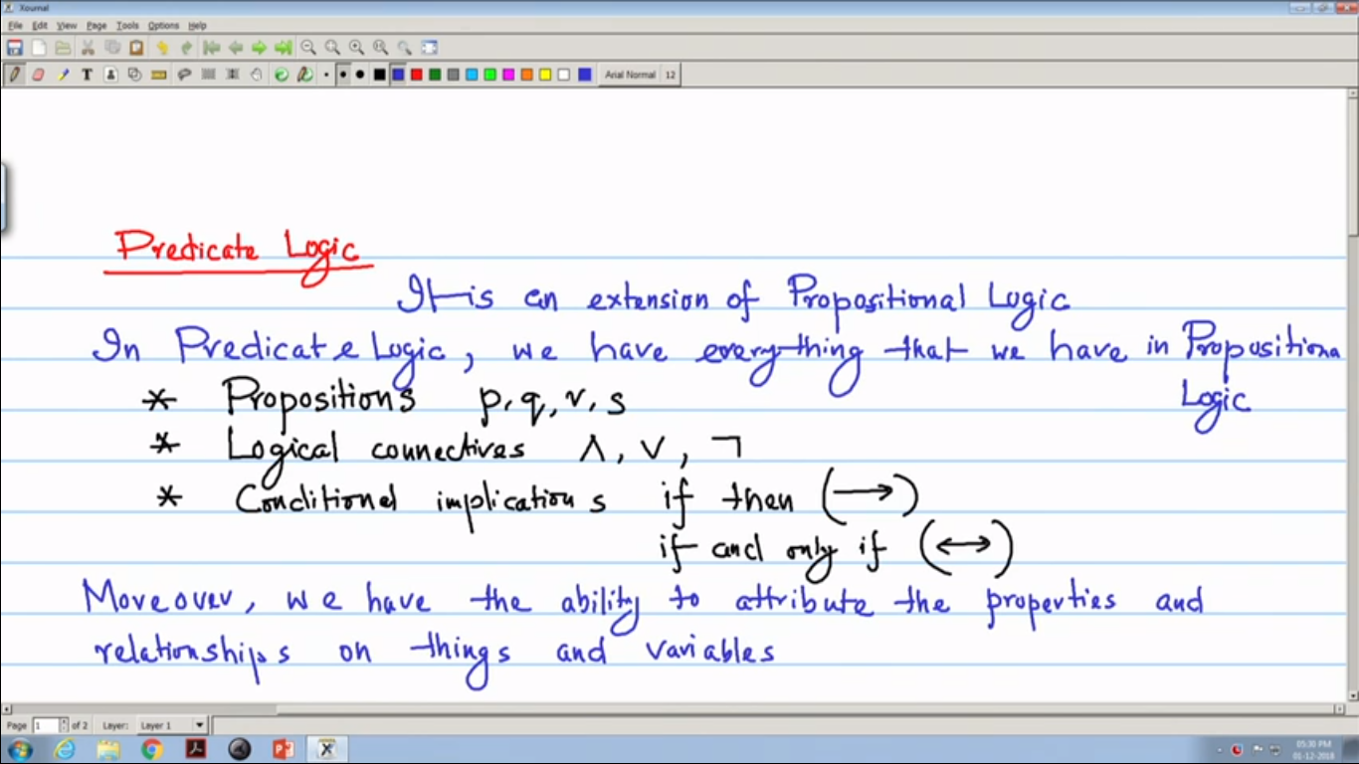

Slide 33
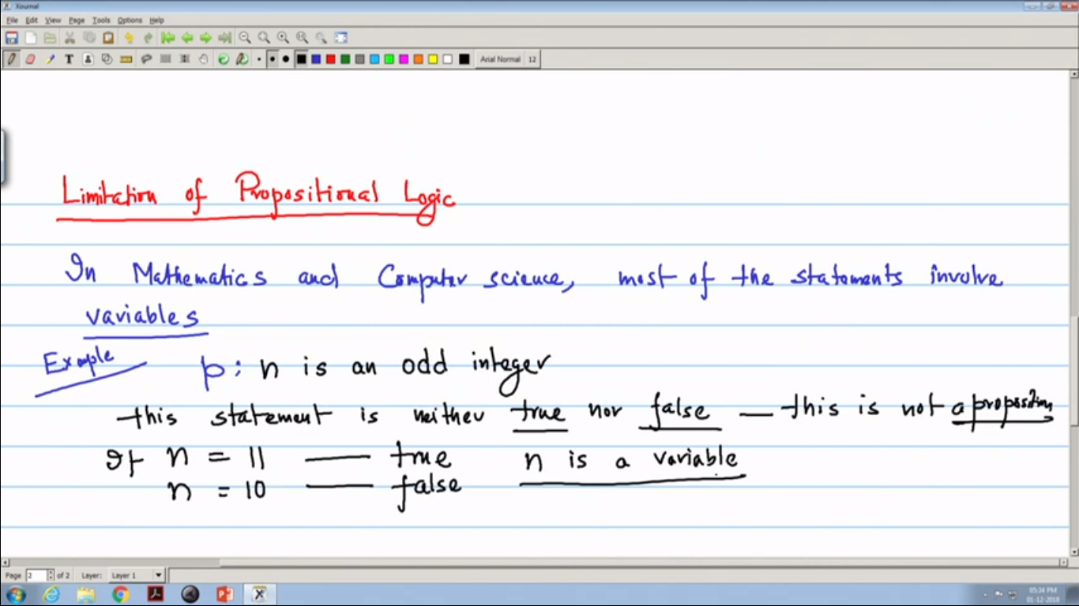

Slide 34
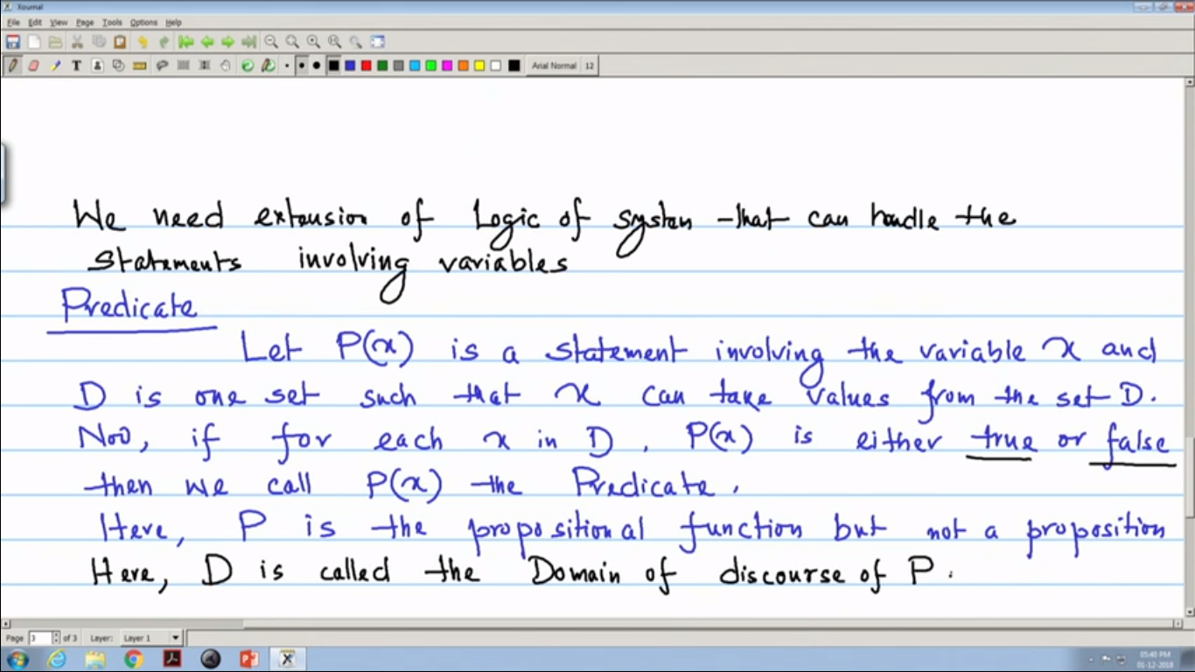

Slide 35
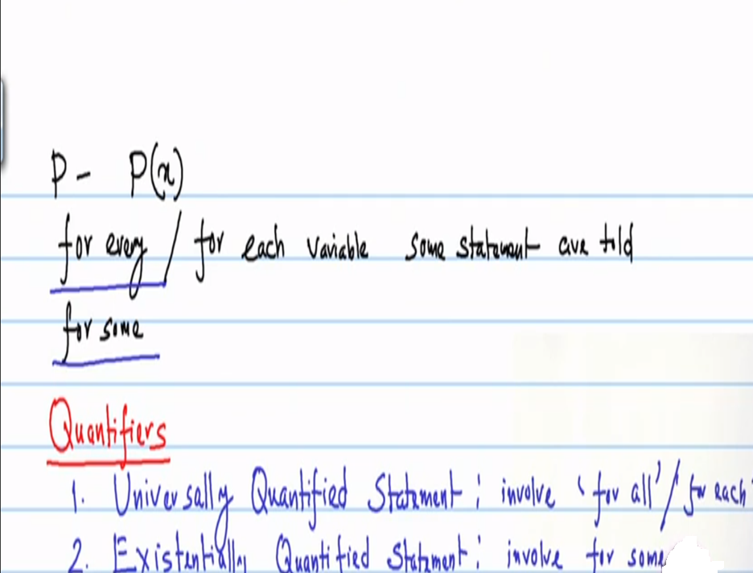

Slide 36
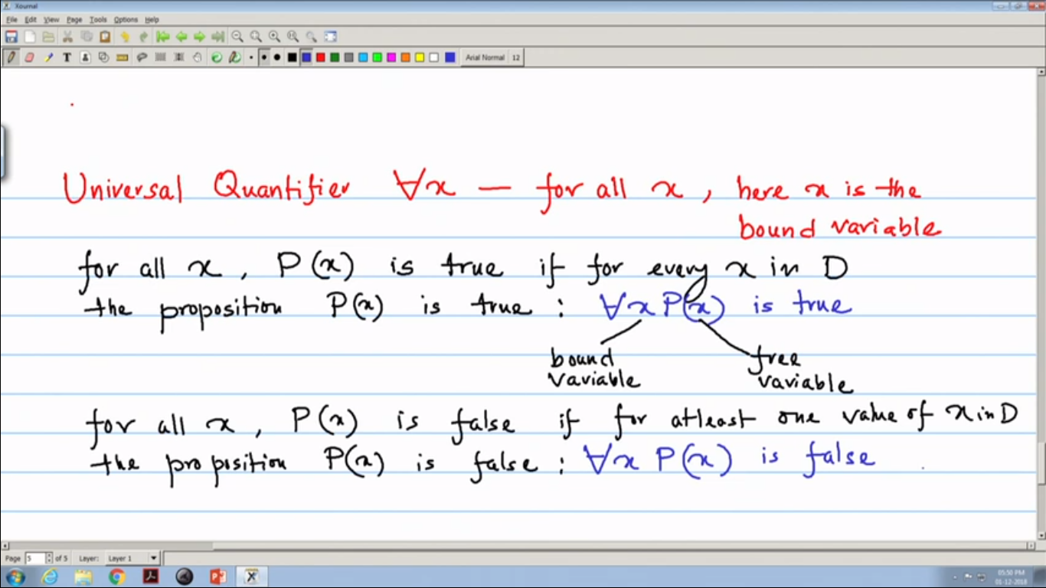

Slide 37
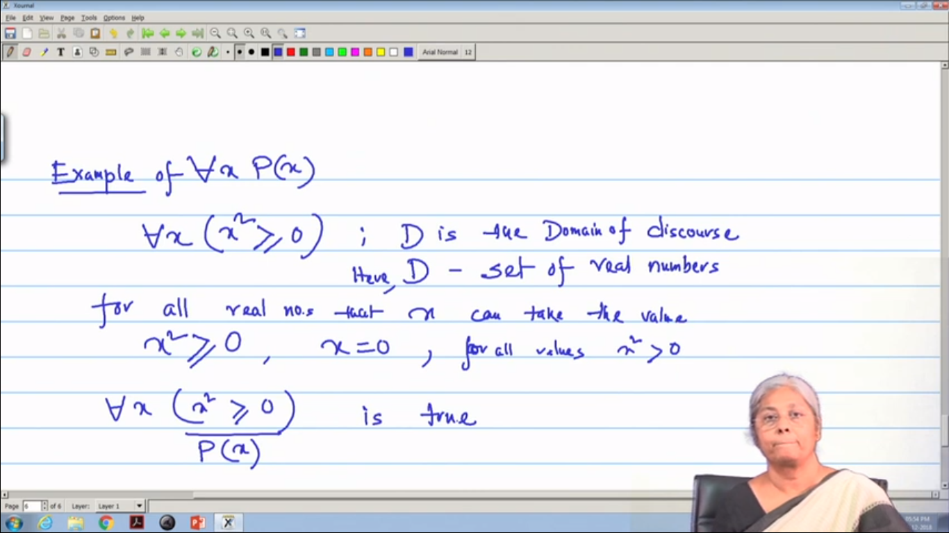

Slide 38
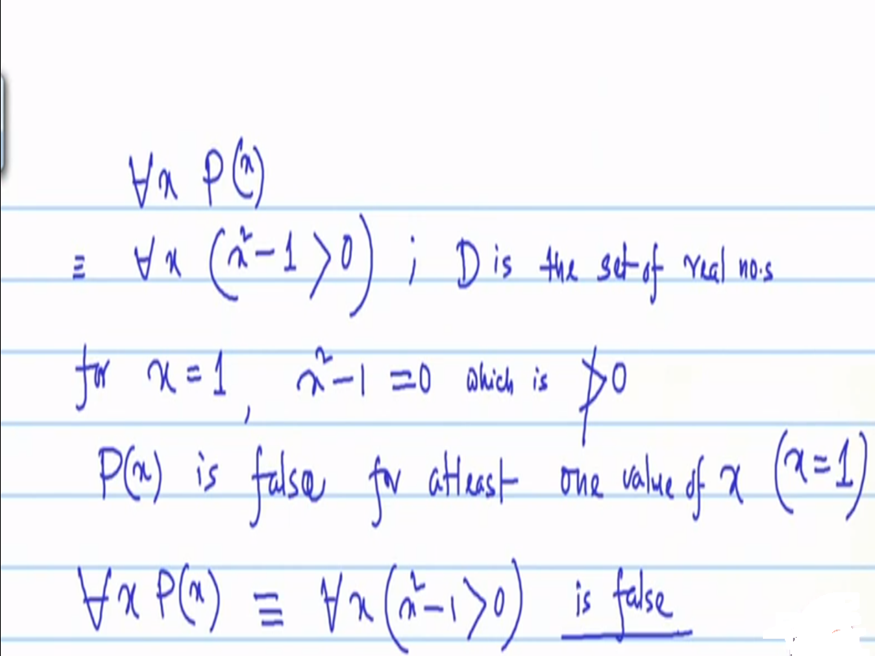

Slide 39
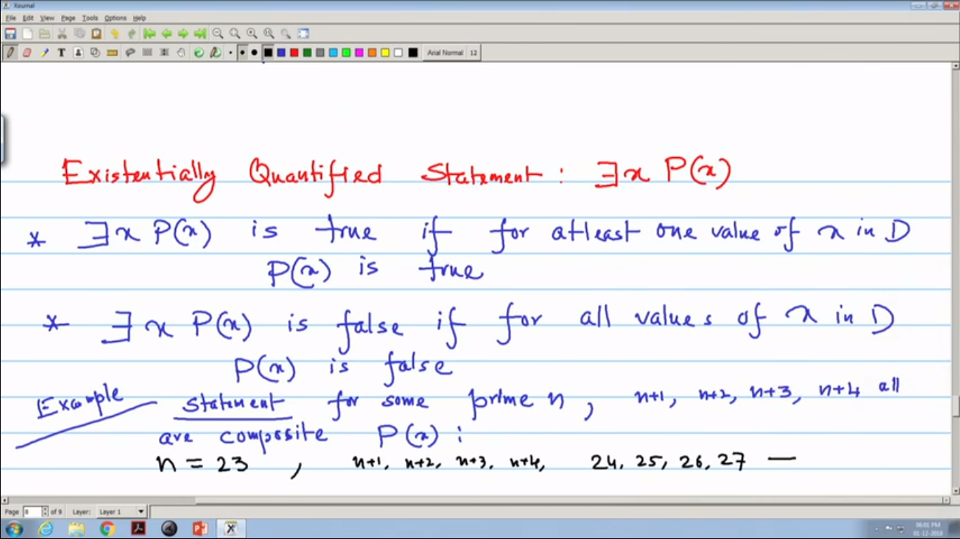

Slide 40
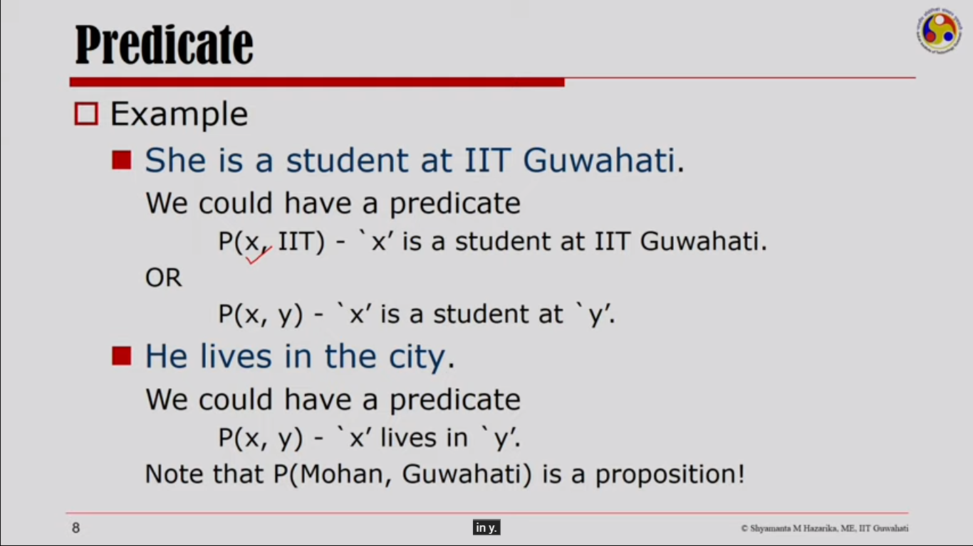

Slide 41
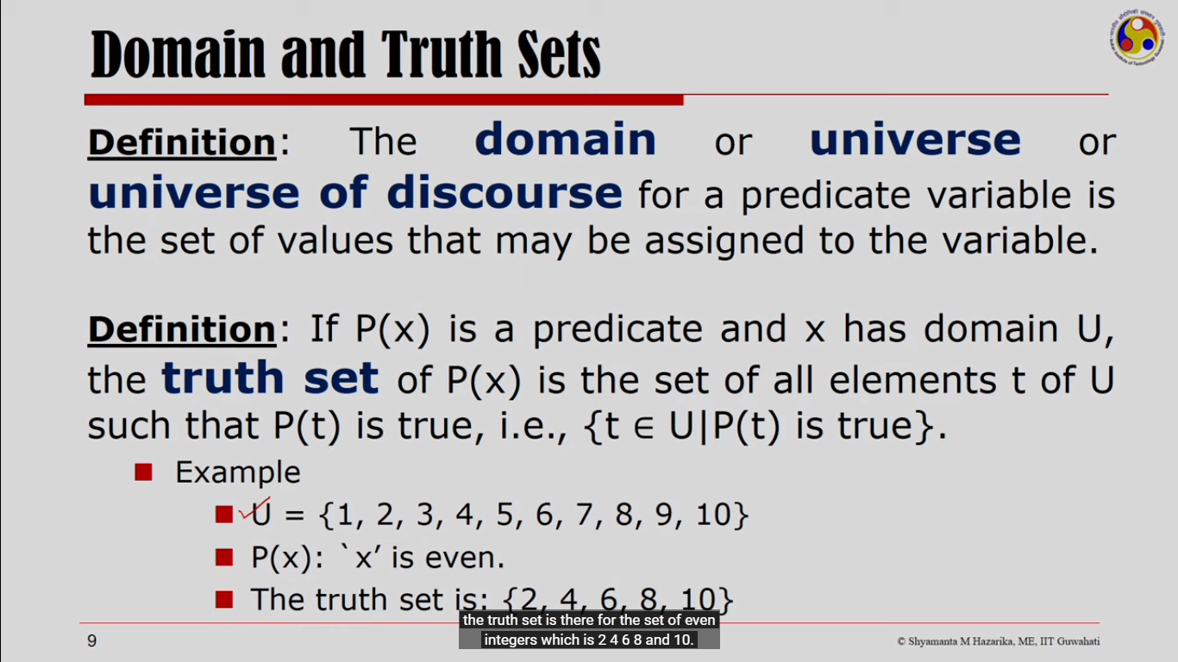

Slide 42
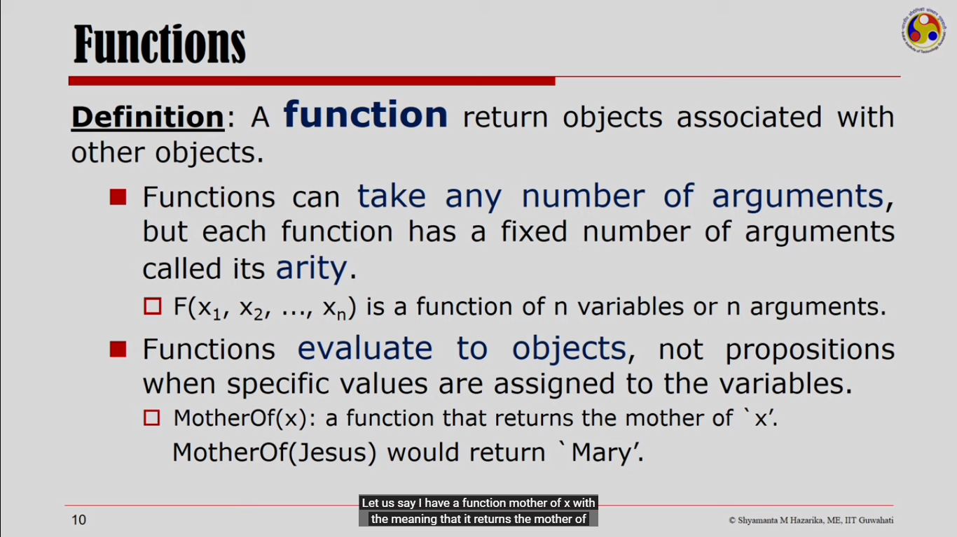

Slide 43
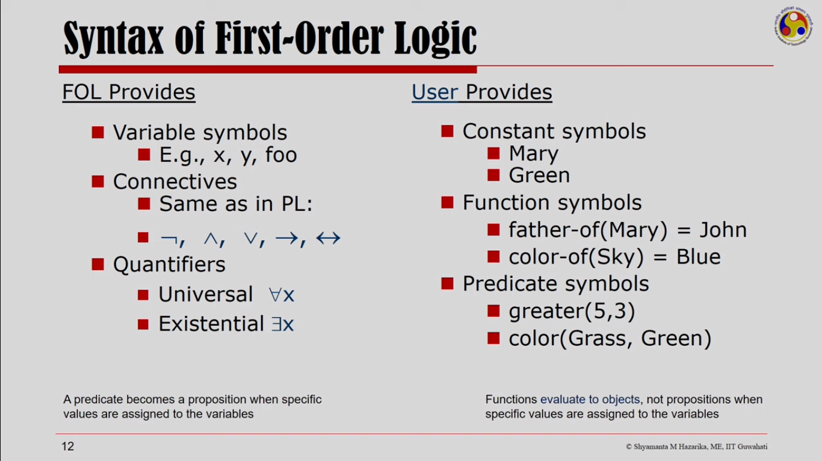

Slide 44
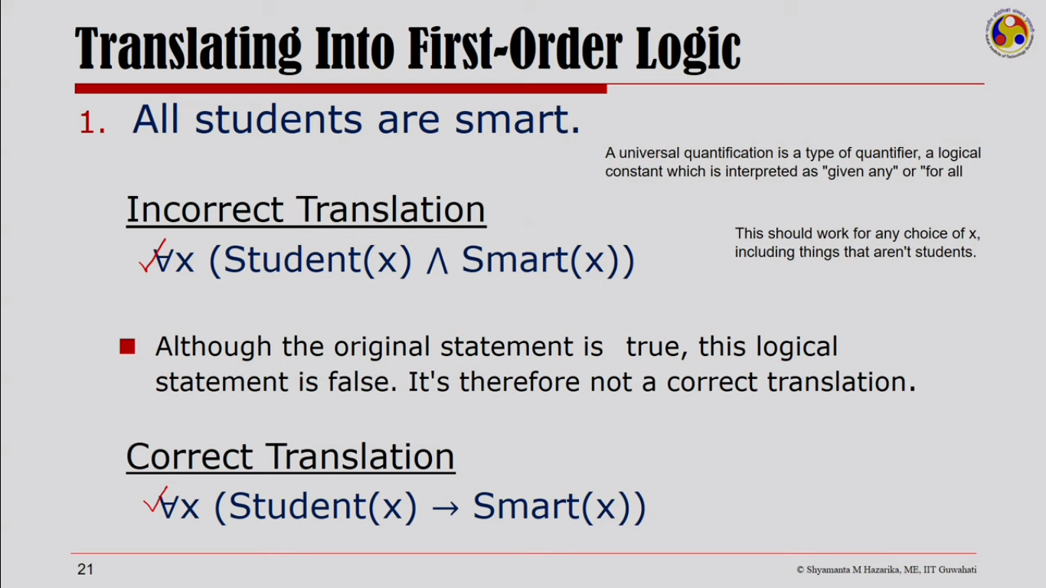

Slide 46
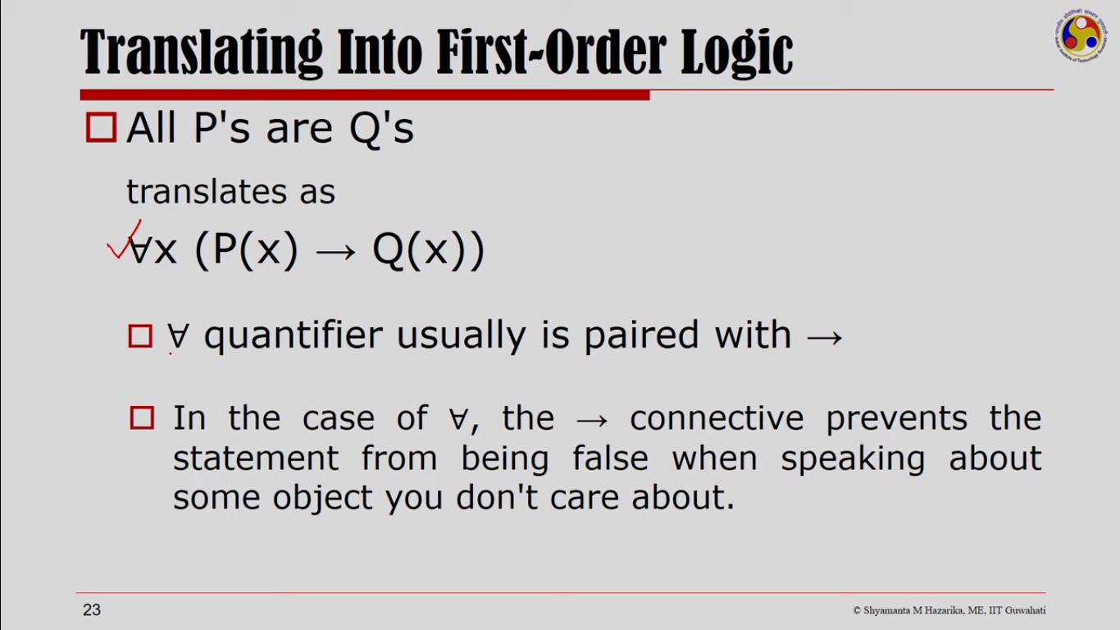

Slide 47
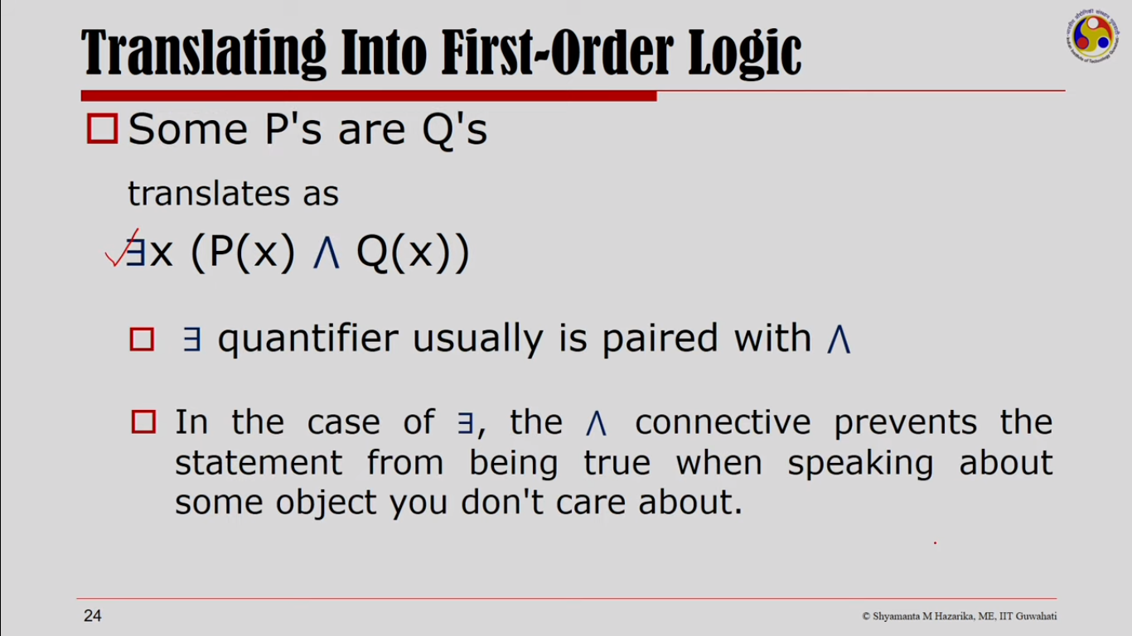

Slide 48
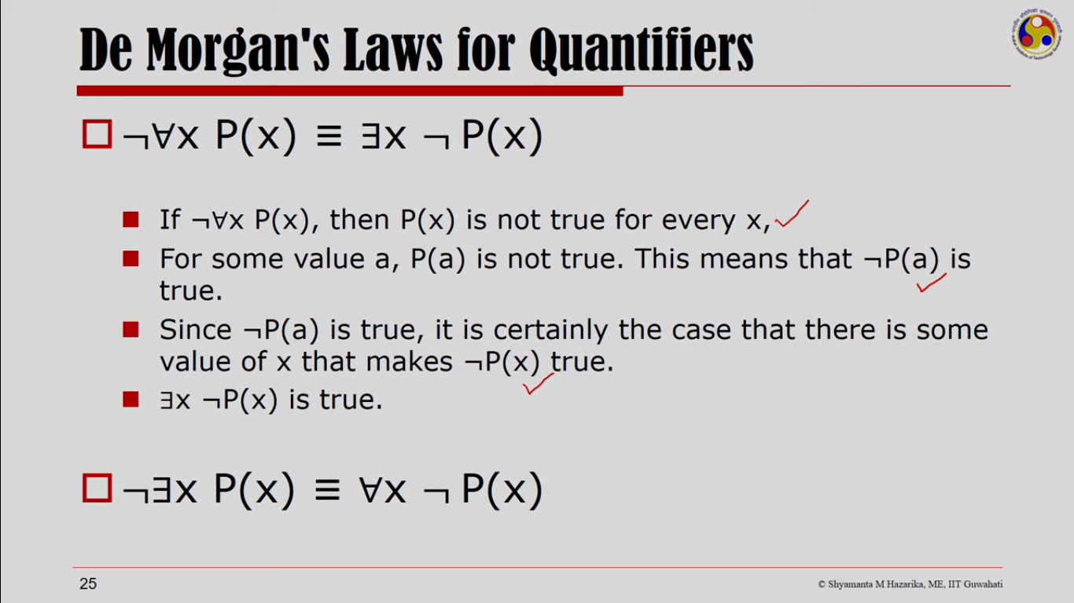

Slide 49
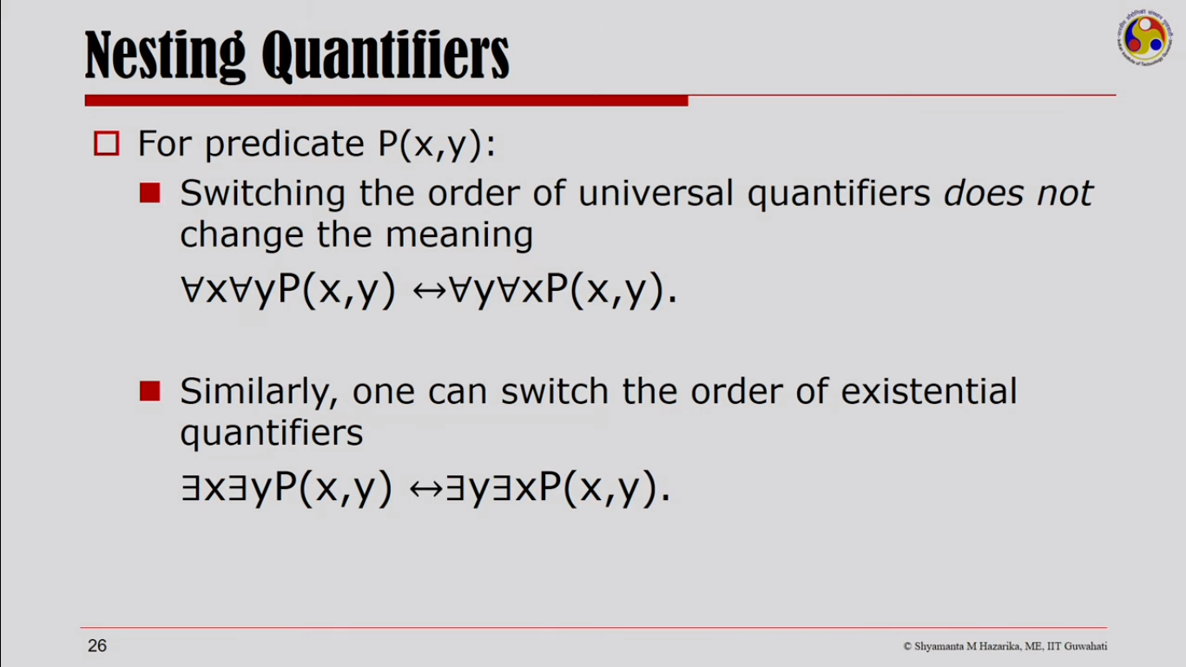

Slide 50
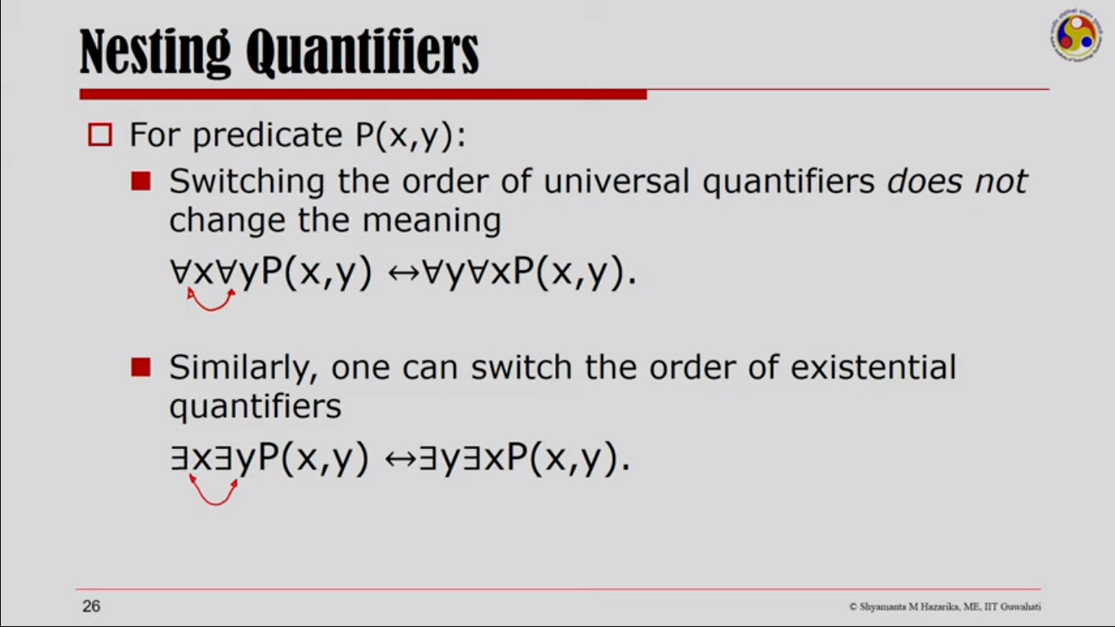

Slide 51
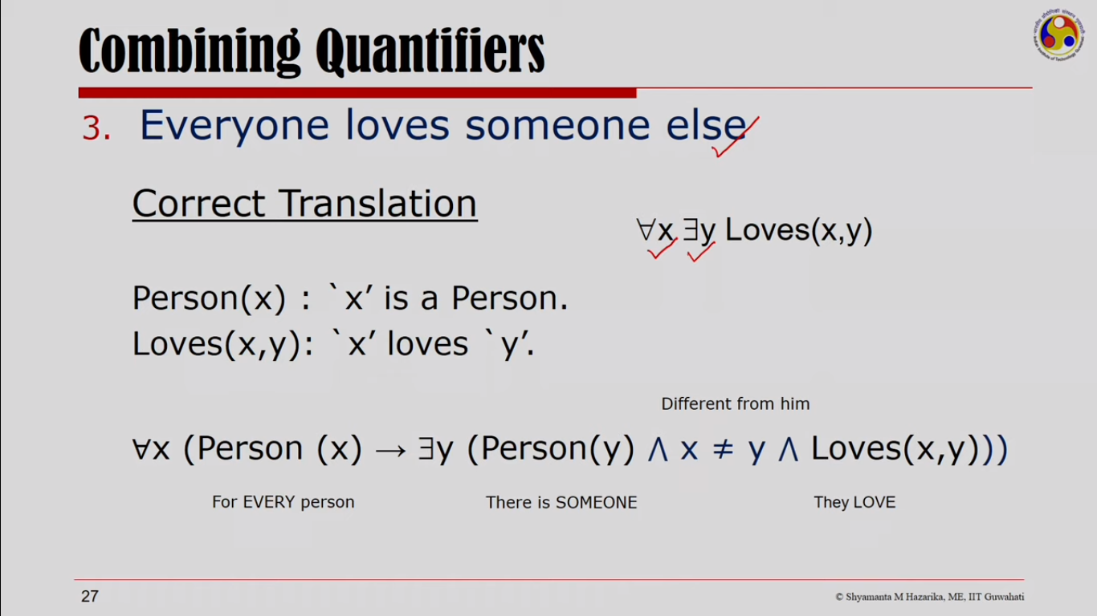

Slide 52
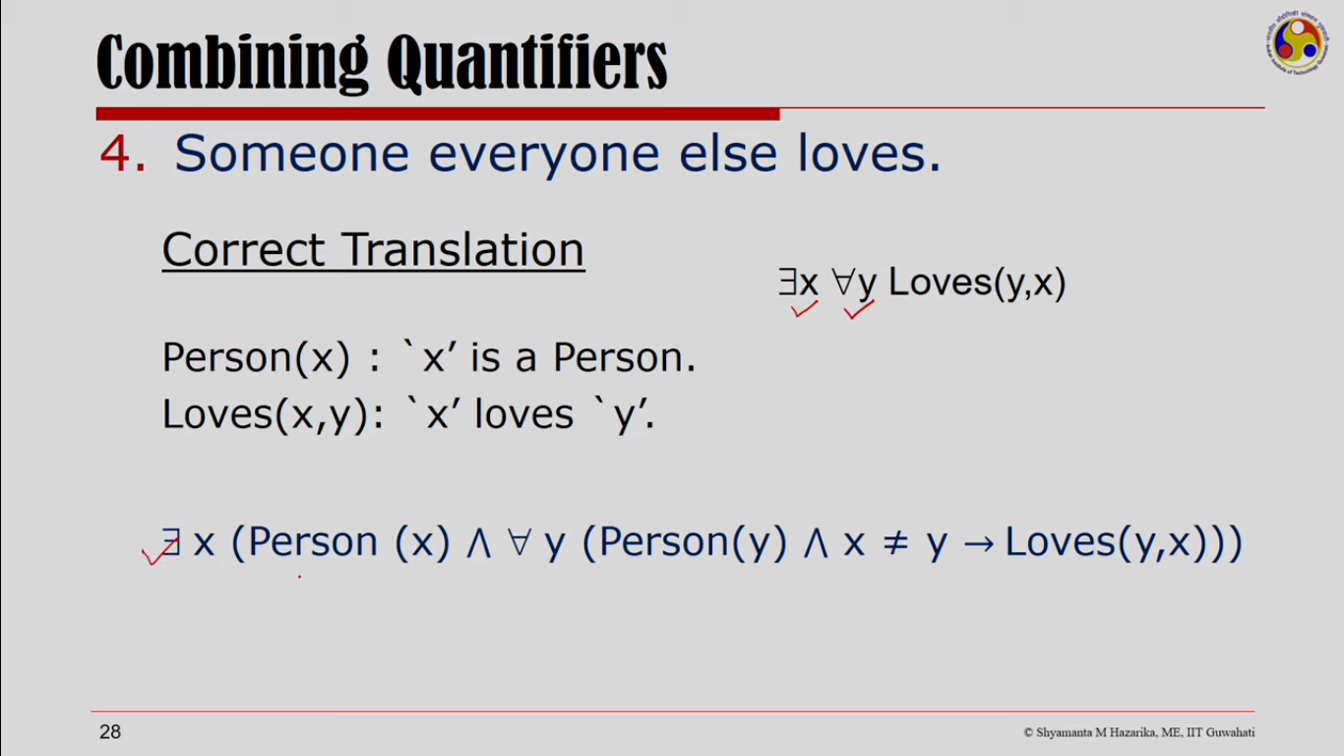

Slide 53
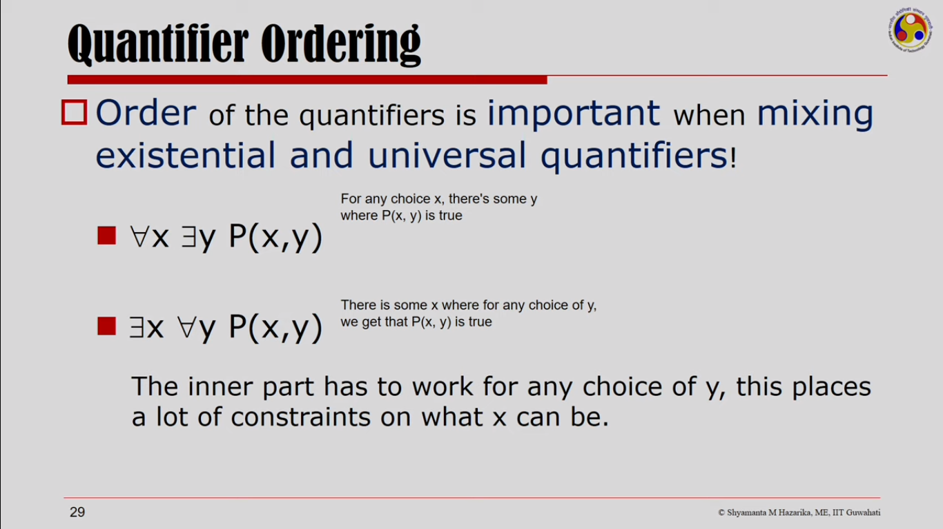

Slide 54
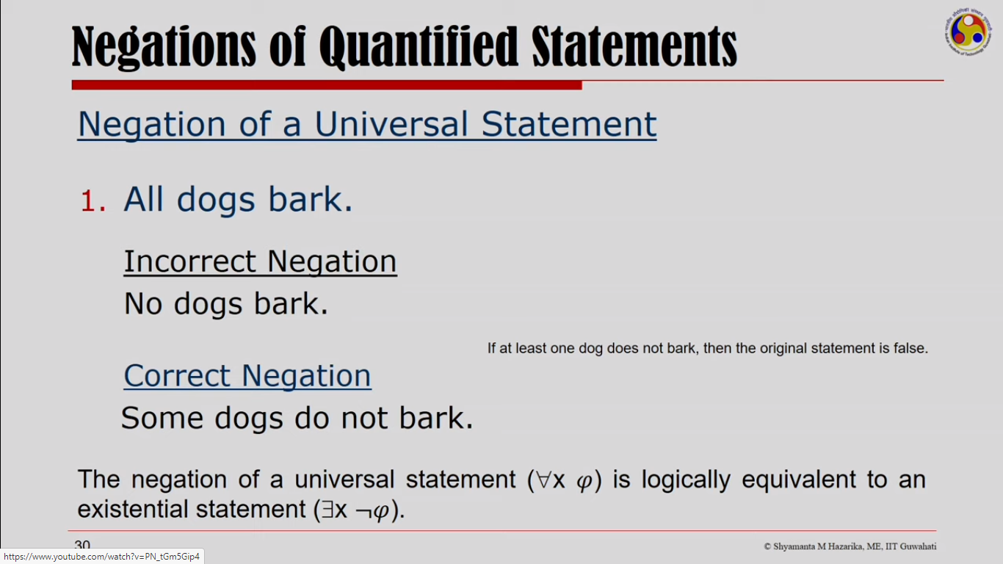

Slide 55
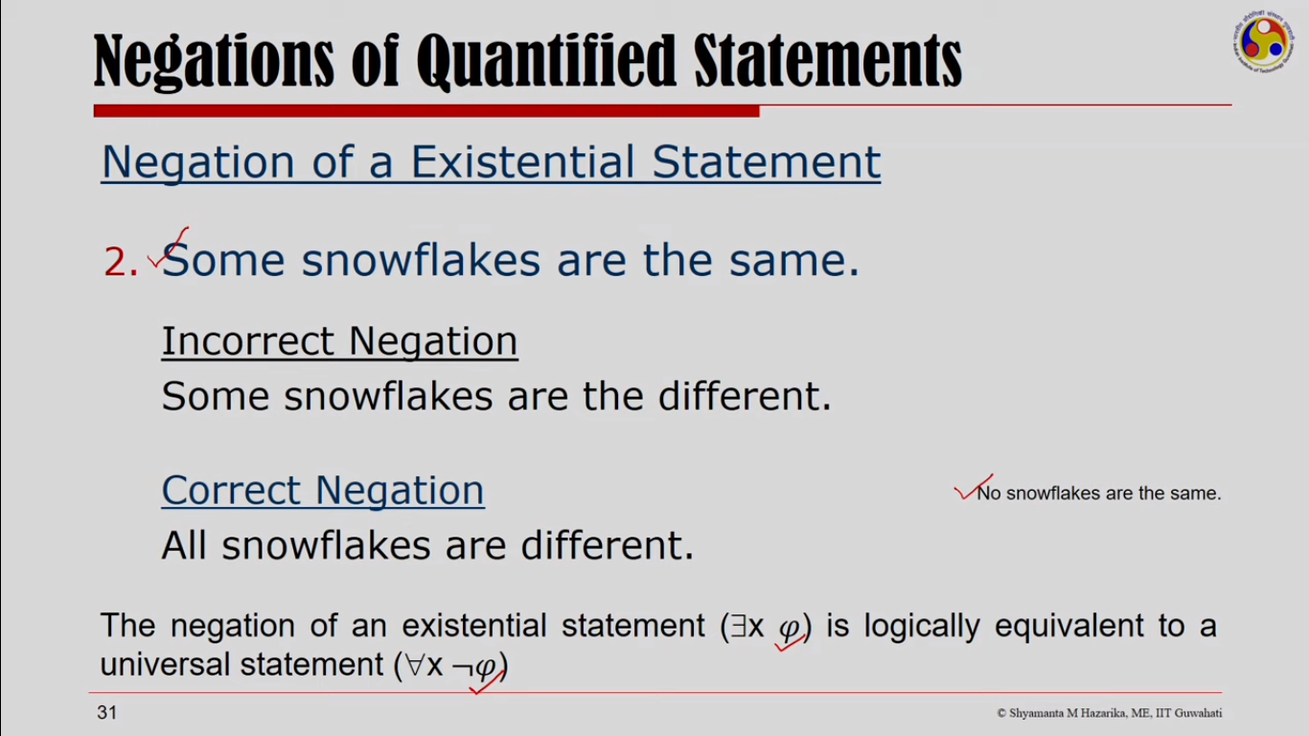

Slide 56
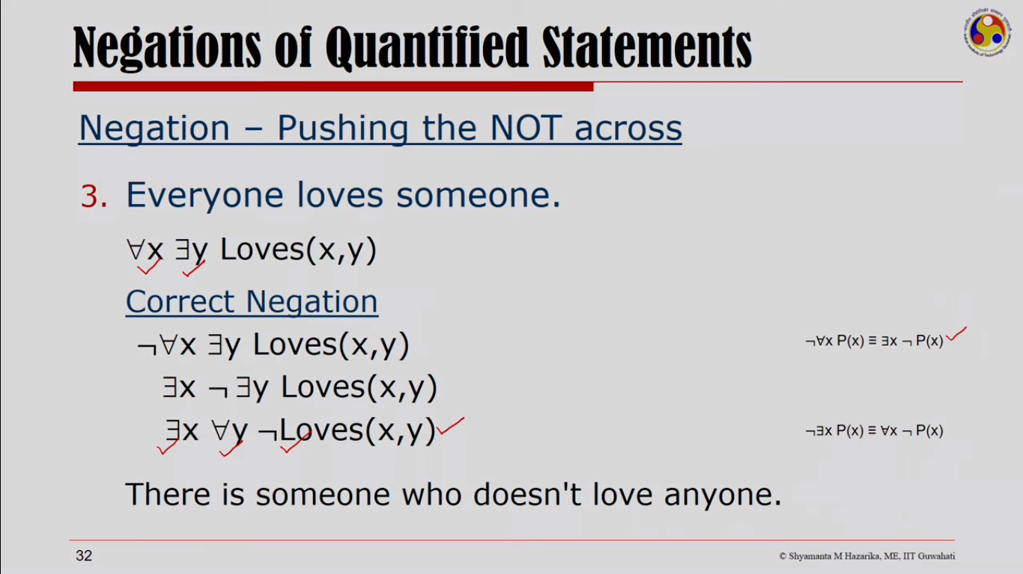

Slide 57
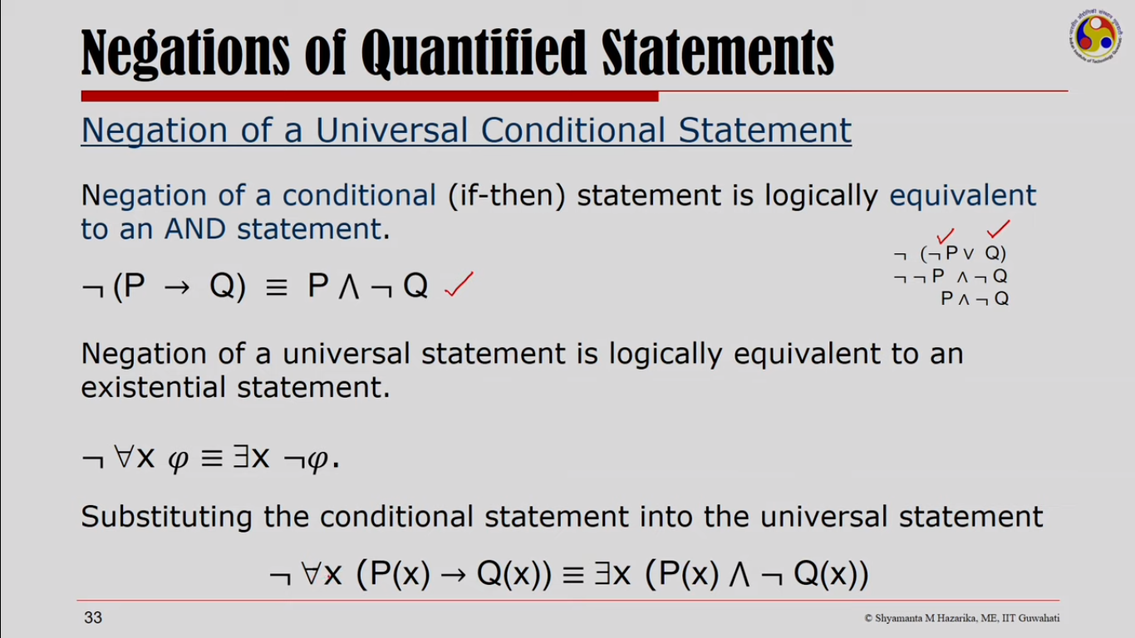

Slide 58
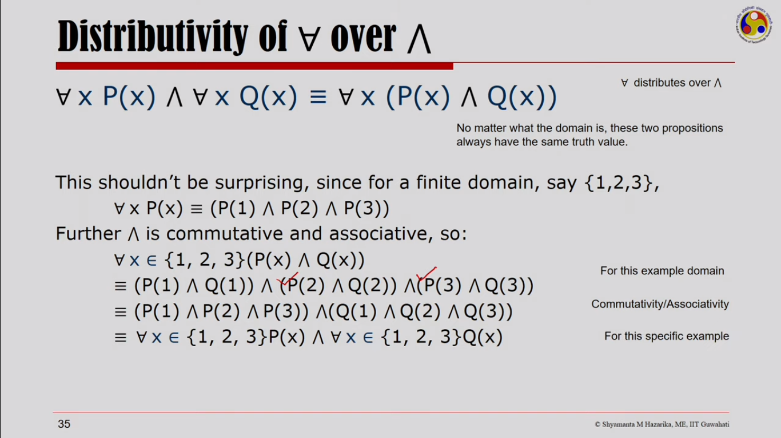

Slide 59
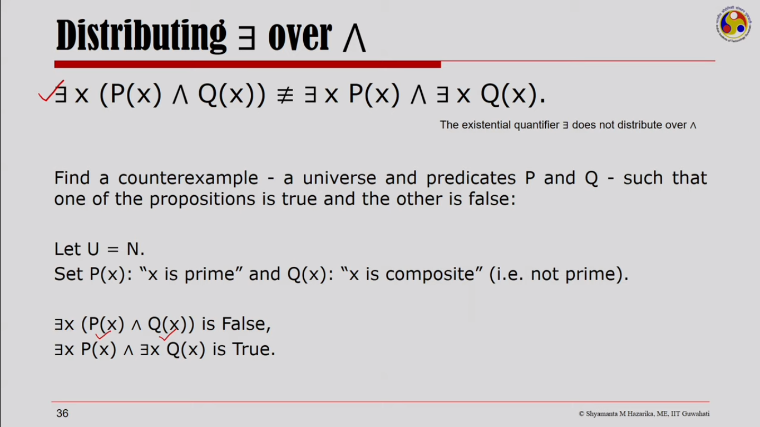

Slide 60
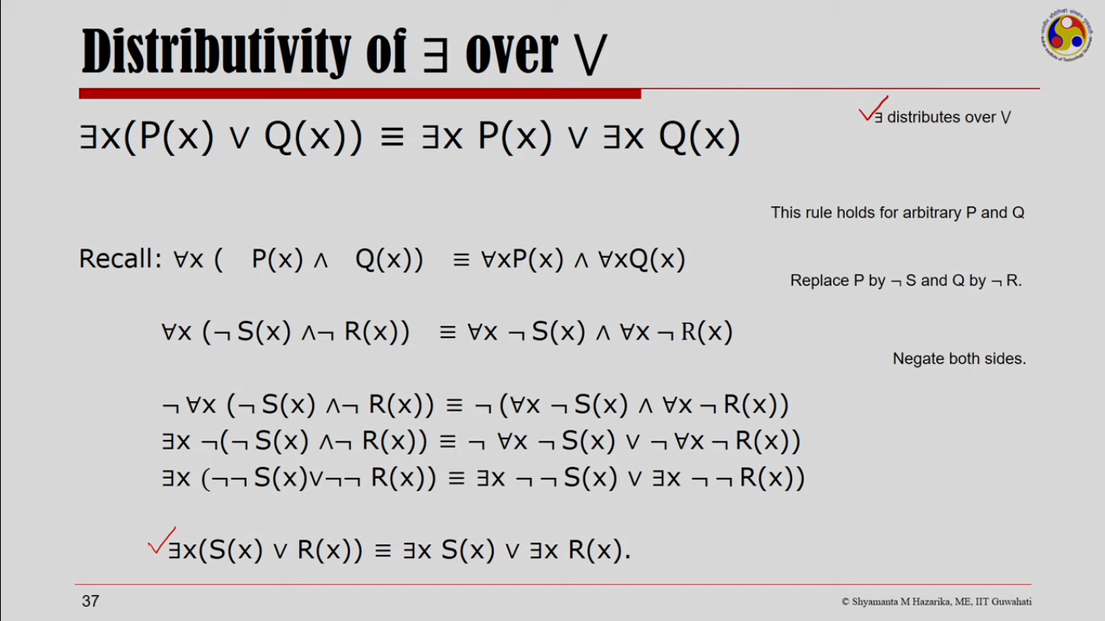

Slide 61
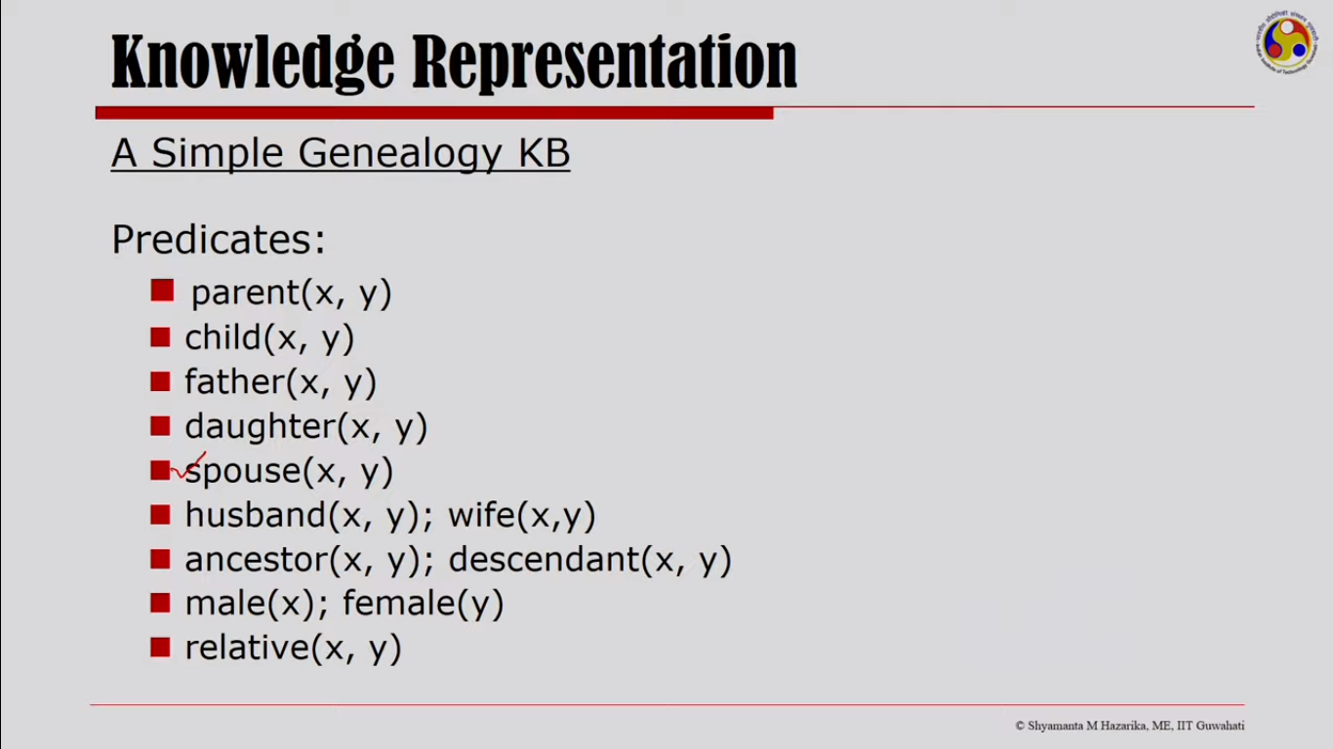

Slide 62
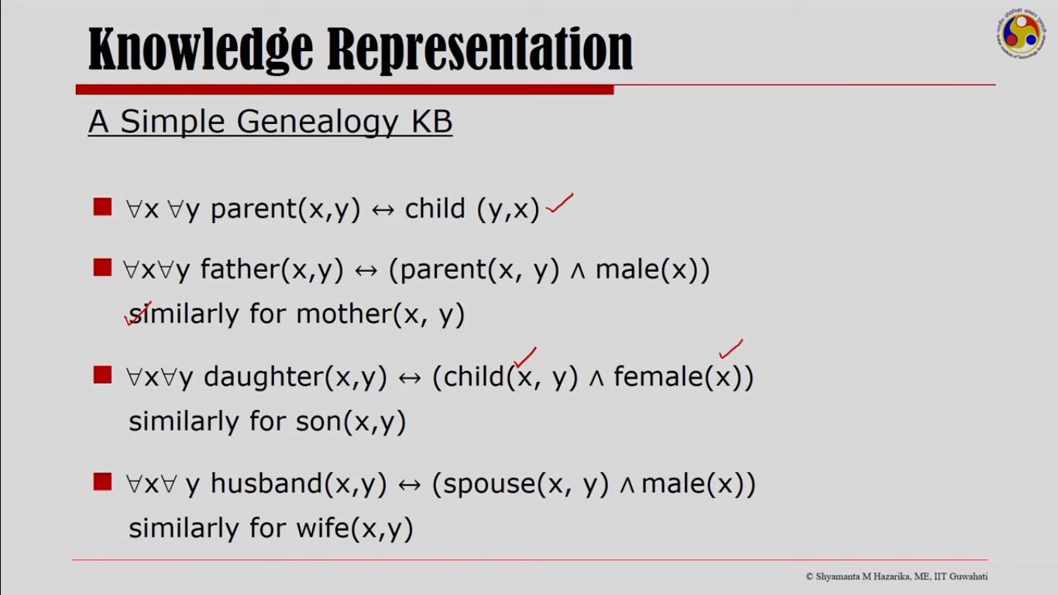

Slide 63
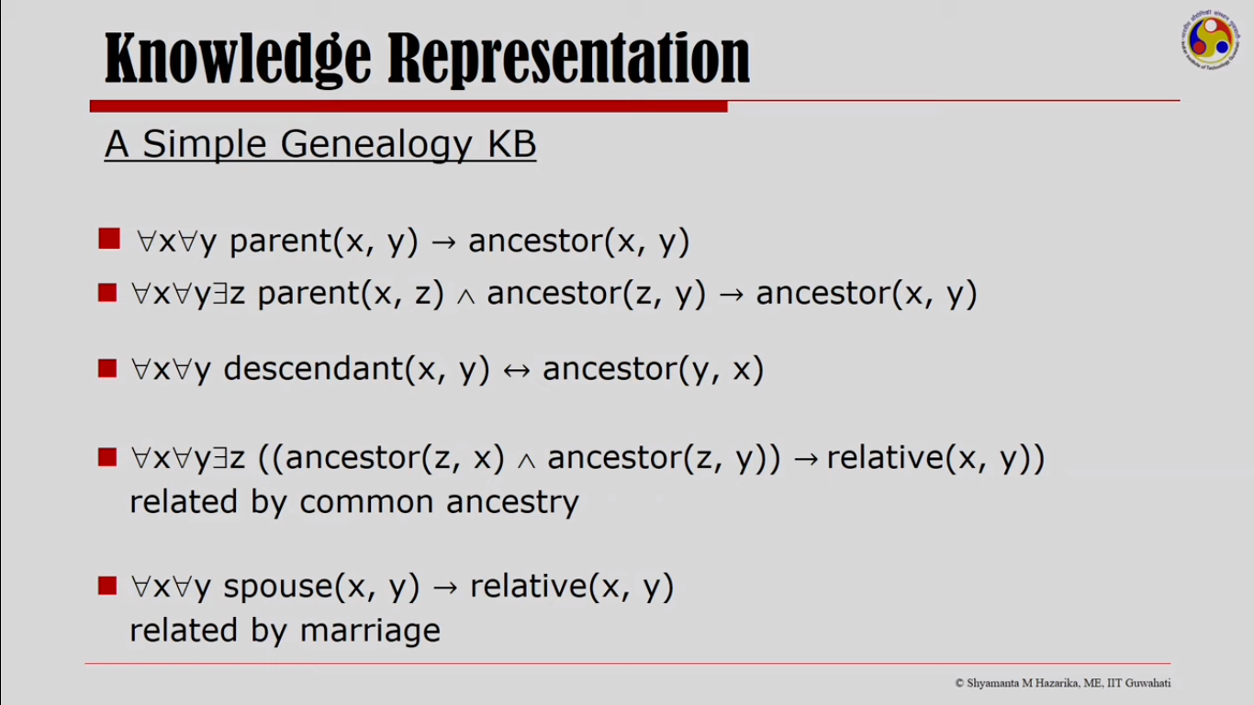

Slide 64
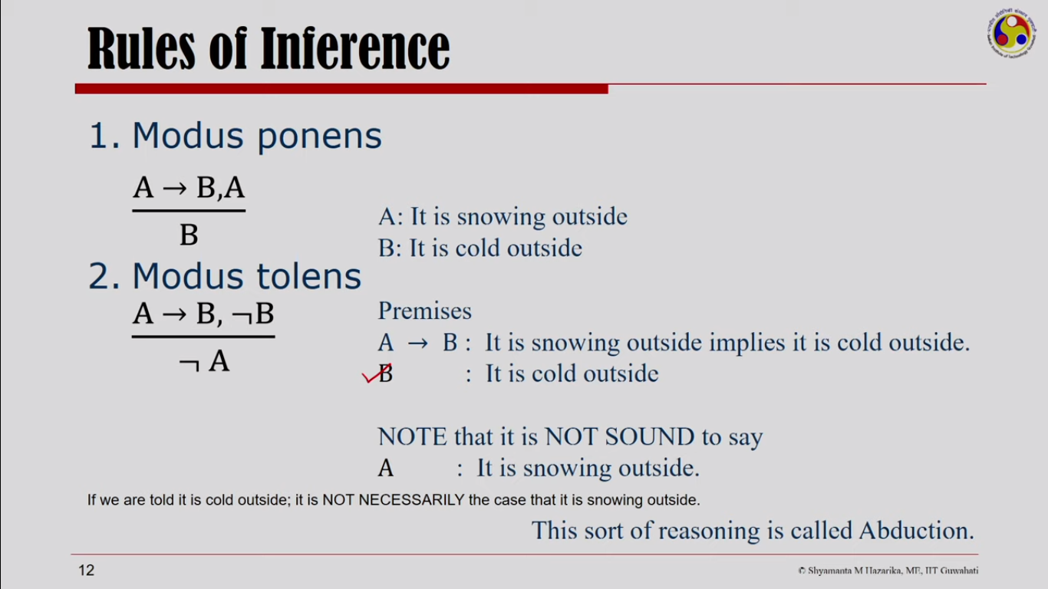

Slide 65
